Slide 1
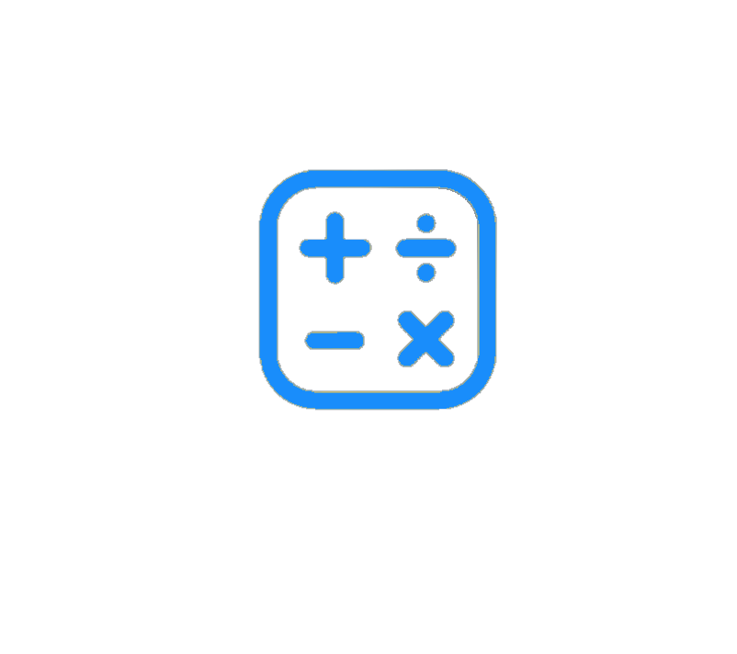
Code crafters

Slide 2
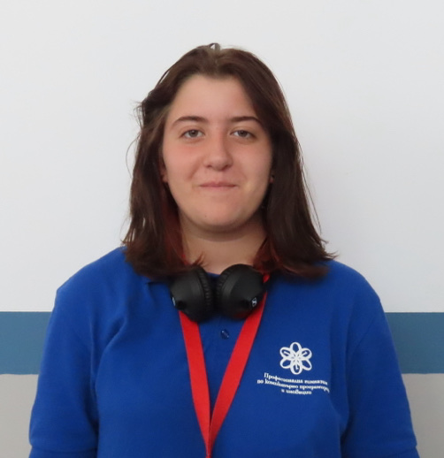
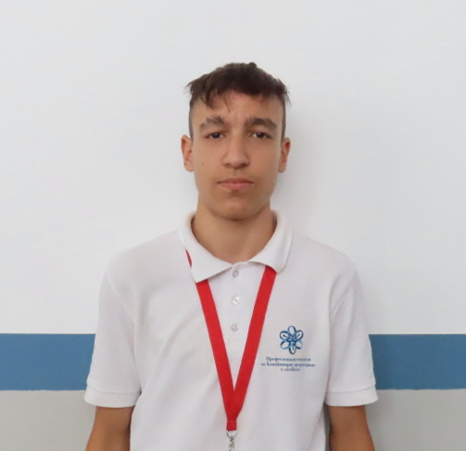
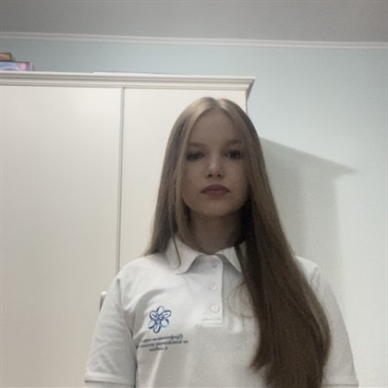
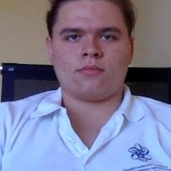
Members of the project
Niq georgieva aleksandur georgiev mila lazarova anastas apostolov

Slide 3
Our idea
our idea is to present the relationship of mathematics with writing code, using the Fibonacci sequence as an example

Slide 4
Stages of the developing
3
Preparing the technology
1
Getting the idea
5
presenting
Getting the idea
Developing the project
Final touches
presenting
2
Developing the project
4
Final touches

Slide 5








Technology we use

Slide 6
let‘s jump to the project

